Slide 1
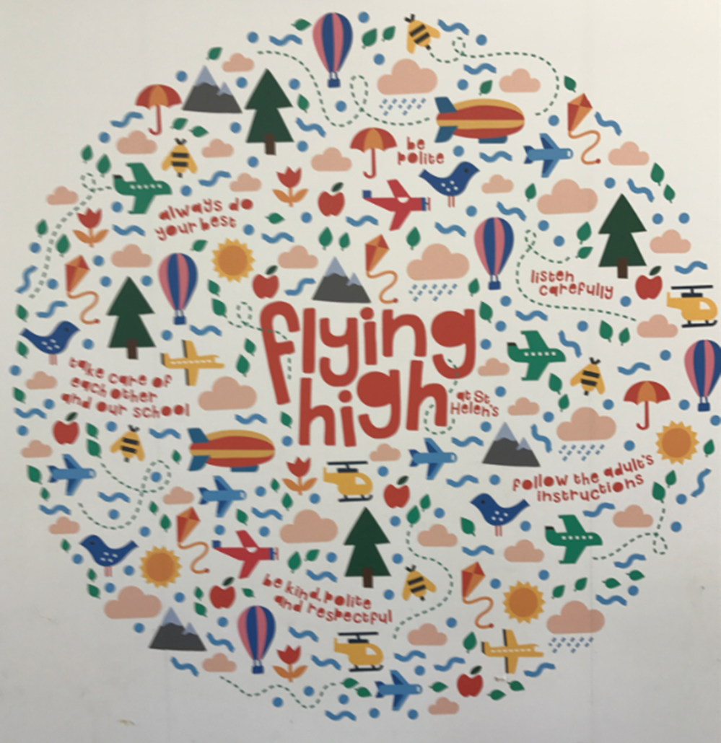
What were the topics?
Year 5 and 6: How do we make our voice heard?
Year 3 and 4: What will your footprint be? What difference do we want to make?
Year 1 and 2: Fantastic beasts and where to find them?

Slide 2
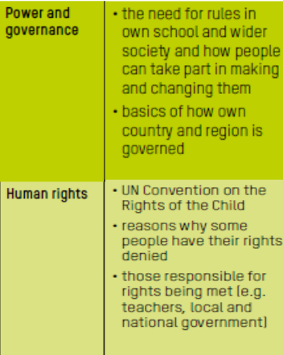
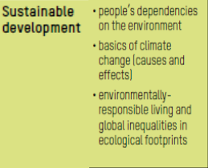
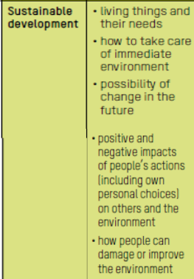
Year 3 and 4: What will your footprint be? What difference do we want to make?
Year 1 and 2: Fantastic beasts and where to find them?
Year 5 and 6: How do we make our voice heard?

Slide 3
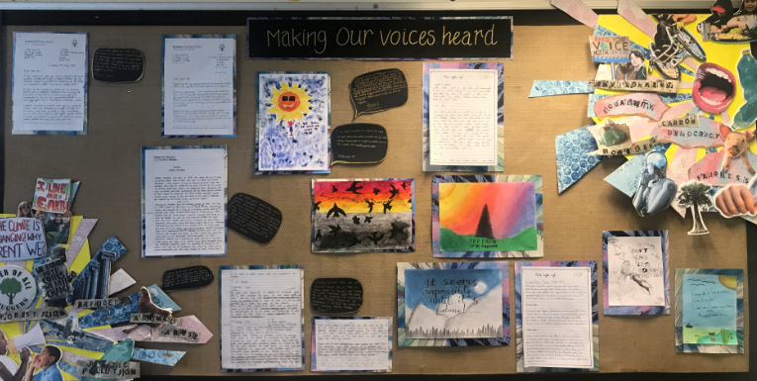
Impact of Curriculum Trial:
Pupil Voice: Year 5 and 6: How do we make our voice heard?

Slide 4
Pupil Voice: Year 6 How to make our voices heard!
We wrote a chronological report about the start of democracy and how it is linked to Ancient Greece.
We also wrote persuasive letters to different companies to ask them to raise money for refurbishing our tulip room in the end terrapin.
We enjoyed this topic as it helped us prepare for secondary school because it would help us make friends and be more courageous to stand up for our rights.

Slide 5
Impact of Curriculum Trial:
Pupil Voice: Year 5 How do we make our voice heard?

Slide 6
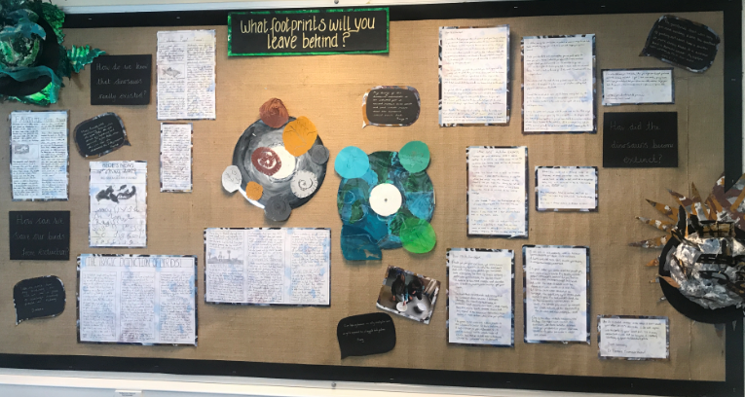
Year 3 and 4: What will your footprint be? What difference do we want to make?

Slide 7
Year 4: What will your footprint be? What difference do we want to make?

Slide 8
Year 3: What will your footprint be? What difference do we want to make?

Slide 9
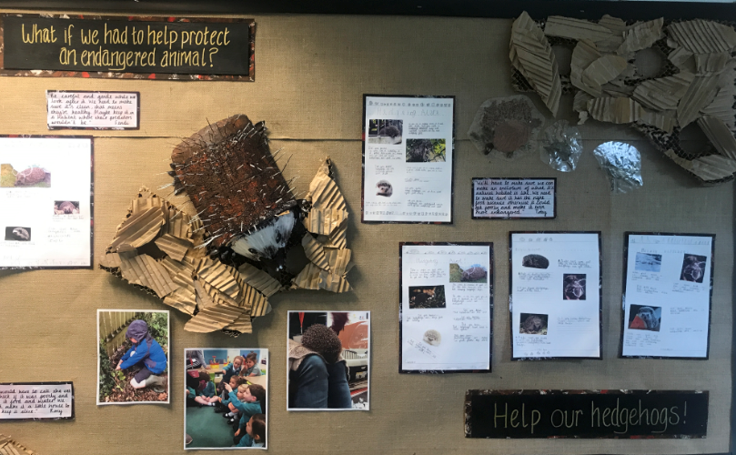
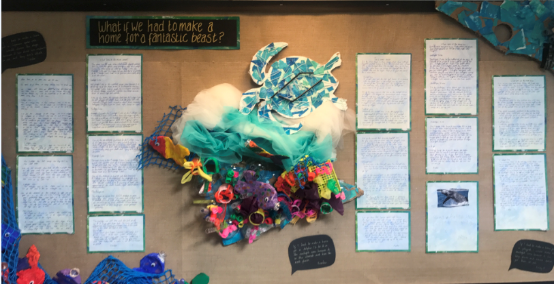
Year 1 and 2: Fantastic beasts and where to find them?

Slide 10
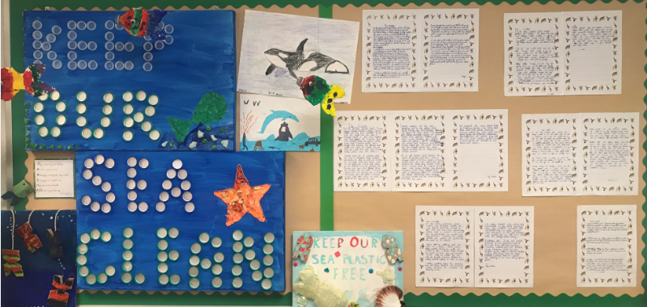
Year 2: What if we had to make a home for a fantastic beast?

Slide 11
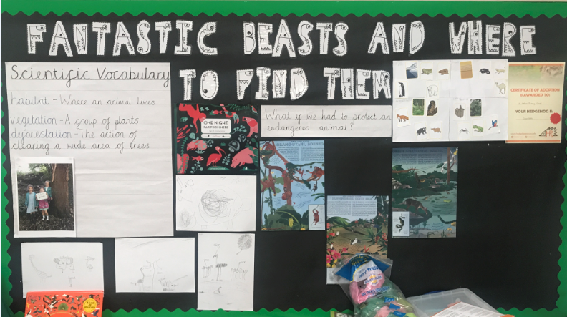
Year 1 : What if we had to protect an endangered animal?

Slide 12
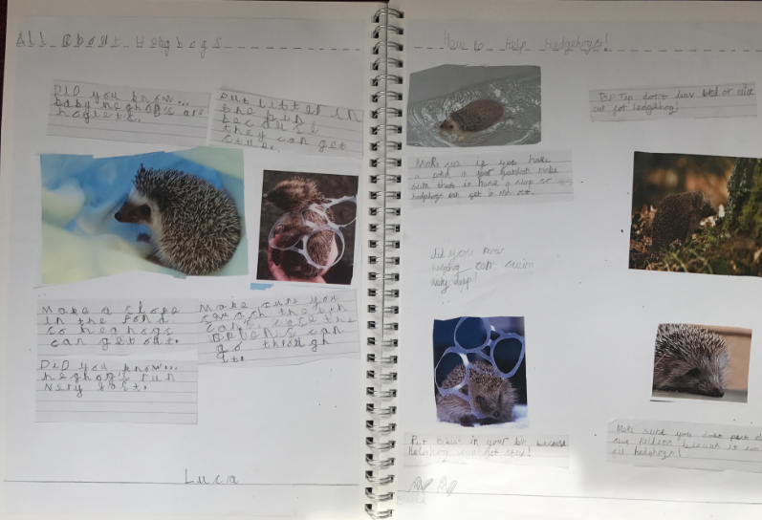
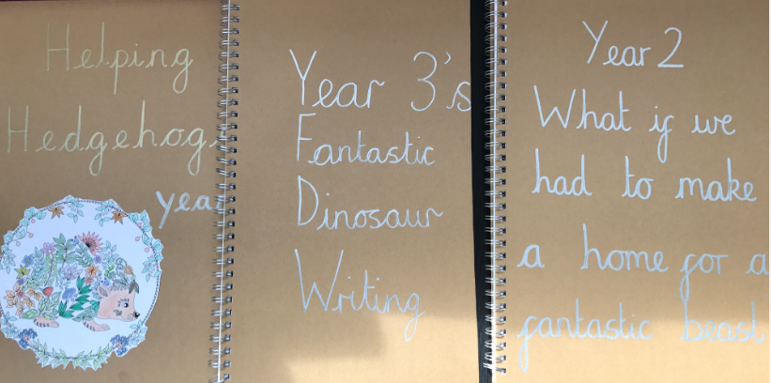
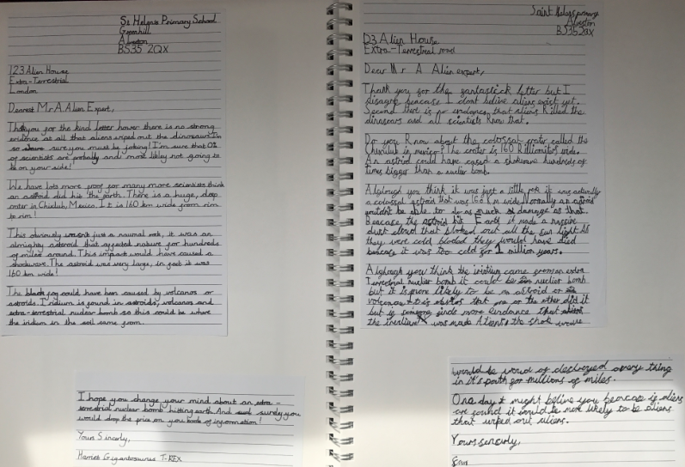
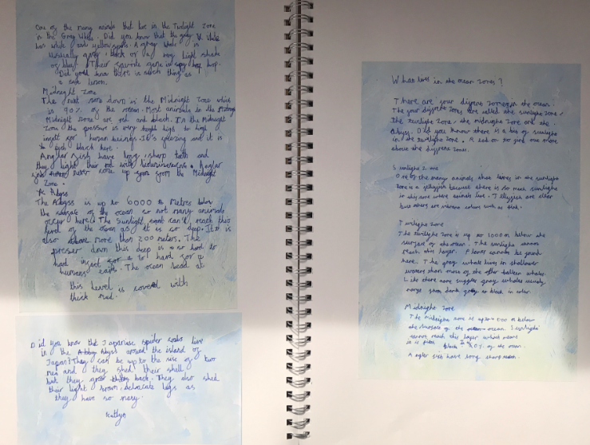
Published Showcase Books:

Slide 13
Impact of Curriculum Trial:
Governors Learning Walk: Friday 5th July
Engagement of both Staff and Pupils was high including children with additional needs.
Children were able to identify with Global themes and greater links to outside the classroom were visible.
A wide variety of writing was in evidence. Persuasive, Posters, Letters, Stories…throughout the writing high quality rich vocabulary was in evidence.
Children showed pride in their work and a willingness to talk about it especially their publishing books.
In Summary: The impact of the Global Curriculum is starting to be seen on the children.

Slide 14
Impact of Curriculum Trial: External thoughts-
Head teacher’s Triads: Tuesday 2nd July
-Engagement is high. Children are keen to talk about their learning. Children all have a voice about what they are learning and are confident to speak about it.
-Writing is a key strength across the school. Children
understand that there is a clear purpose for writing and they are keen to improve it
Displays of learning bring the curriculum alive. Children can talk about them and about their learning. Children are proud about the learning display books and have the opportunity to read each other’s writing.
Children talk about the books that have inspired them in their topic. These texts have been used as a hook for the children and they talk about how much they enjoy this and are inspired by them.
Children talked about the fact that they enjoy the topics where they don’t know very much about at the beginning, but then have the opportunity to learn and explore.
There is vocabulary linked to the topic on display in each of the classrooms which is used to support the writing.
Presentation in children’s books is strong and children take pride in their learning
Children are confident to talk about the curriculum and articulate their learning using vocabulary from the cross curricular e.g. habitat, extinct, endangered

Slide 15
What next….?
Children continue to look at becoming Global Citizens as we will to continue to plan using Global Curriculum Objectives for Term 1 and 2 2019.
EYFS to focus on a strand of the Global Curriculum.
Partnership development with St.Mary’s CE School will see a curriculum designed and implemented for January 2020.

Slide 16
Impact of Curriculum Trial:
Parents Voice:
I think….
I noticed….
I would like to
find out…..
My children….
I really like..
I would like to know
more…

